Slide 1
BILATTICES FOR DEDUCTIONS
IN MULTI-VALUED LOGIC
G. Gerla, Università degli Studi di Salerno
ITALY

Slide 2
Abstract logic is defined as follows
Definition. An abstract semantics is a complete lattice L together with a subset M of L. The elements in M are called models or worlds. If m≥x, then we say that m is a model of x, in brief M |= x.
The elements in L are interpreted as pieces of information
A world m is identified with the total information on m we can have.

Slide 3
Definition. The logical consequence operator Lc : L →L is defined by
Lc(x) = Inf{m∈M : m |=x} = Inf{m∈M : m ≥ x}.
We set
Tau = Lc(0) = Inf(M).
Lc(x) is the information shared by all the models of x.
Tau is the information shared by the totality of models.

Slide 4
Definition. A step-by-step abstract deduction system is a tern
(L, la, Ir) such that
- L is a complete lattice (lattice of possible pieces of information),
- la∈L (a-prior-information),
- Ir : L →L is a continuous operator (inference-rules operator).
Set Ic(x) = x∨la∨Ir(x). Then the associate deduction operator D : L→L is defined by setting
D(x) = lim_{n∈N} Ic^{n}(x),
Definition. An abstract logic is defined by an abstract semantics (L, M) and an abstract step-by-step deduction system (L, a, Ir) such that D = Lc.

Slide 5
I recall the notion of continuity
Definition. Given a complete lattice L, we say that a subset C of L is upward directed provided that
∀x∈C∀y∈C ∃z∈C(z≥x ∧ z≥y).
We call limit of a directed subset C the element
limC = Sup(C).
Every totally ordered set C is directed.
Definition. We say that an order-preserving operator H : L→L is continuous provided that
H(lim(C)) = lim(H(C)).

Slide 6
ABSTRACT FUZZYLOGIC
Definition. An abstract fuzzy logic is an abstract logic in which L = [0,1]^{F}
(more in general L = V^{F} where V is a valuation structure)
So the semantics is defined by a class M of fuzzy sets of formulas , i.e. we identify a model with the fuzzy subset of formulas which are true in this model.
The deduction apparatus, is defined by a continuous operator
Ir : [0,1]^{F} → [0,1]^{F}
Which is defined by a set of inference rules and a fuzzy subset of logical axioms

Slide 7
ABSTRACT FUZZY LOGIC BY BILATTICES
We will extend this approach by using the notion of bilattice.
- a deduction apparatus has to be a tool to manage information on truth values and not directly truth values of the formulas
- truth and false can have the same role in the deduction processes (not only from the truth of the axioms to the truth of the theorems)

Slide 8
We start from a valutation structure.
For example a structure V = (V, ≤, ⊗, ∼, 0, 1) such that
- (V, ≤, ∼, 0, 1) is a complete lattice with an involution and
(V, ⊗, 1) is a commutative monoid,
⊗ is infinitely distributive, i.e., for every x∈V and a nonempty C⊆V
x⊗Sup(C) = Sup(x⊗C) and x⊗Inf(C) = Inf(x⊗C).
We denote by ⊕ the operation defined by setting
x⊕y = ∼(∼x⊗∼y)

Slide 9
MAIN DEFINITION
Given a valuation structure V, a k-extension of V is a pair (B,i) where B = (B, ≤_{t}, ≤_{k}, ⊗_{t} , ∼, False, True, ⊥, ⊤) is a structure such that
- (B, ≤_{t}, False, True) and (B, ≤_{k}, ⊥, ⊤) are complete lattices,
- ∼∼(x) = x ; x ≤_{t} y ⇒ ∼y ≤_{t} ∼x ; x ≤_{k} y ⇒ ∼x ≤_{k} ∼y.
- (B, ⊗_{t}, False, True) is a commutative monoid with zero element False which is infinitely distributive with respect to the bilattice operations.
i : V →B is an embedding of V into the reduct (B, ≤_{t}, ⊗_{t} , ∼, False, True).
Note: (B, ≤_{t}, ≤_{k}, ∼, False, True, ⊥, ⊤) is named bilattice with negation in literature (Fitting) and is proposed in the framework of logic programming to accept the negation in the body of a rule.

Slide 10
≤_{t} is called truth order
≤_{k} is called knowledge order.
Indexes t and k are used to distinguish the same notions defined with respect to ≤_{t} and ≤_{k}.
The intended interpretation is that an element in B is a piece of information about an unknown element in V, i.e. on a truth value of a formula.
Moreover, given λ∈V, i(λ) is the total information on λ.

Slide 11
Definition. Let (B,i) be a k-extension of V, λ ∈V and b∈B. Then:
a correct piece of information on λ is an element b≤_{k}i(λ) (in such a case we write λ ⊨ b)
(Since i(λ) is the complete information on λ, a piece b of i(λ) is a piece of information on λ)
we say that b is satisfiable provided that there is λ∈V such that λ ⊨b.

Slide 12
EXAMPLE 1: SQUARE k-EXTENSION
Put B(V) = (V×V, ≤_{t} , ≤_{k} , ⊗_{t ,} ∼, False, True, ⊥ , ⊤), where
(x, x’) ≤_{t} (y, y’) ⇔ x ≤ y and y’ ≤ x’ ;
(x, x’) ≤_{k} (y, y’) ⇔ x ≤ y and x’ ≤ y’;
False = (0, 1), True = (1, 0);
⊥ = (0, 0), ⊤ = (1, 1);
(x, x’)⊗_{t}(y, y’) = (x⊗y, x’⊕y’).
∼(x,x’) = (x’,x).
Define i : V →B by setting
i(λ) = (λ,∼λ).
One can think that the components x, x’ of a pair (x, x’) summarize the evidence for and the evidence against an assertion.

Slide 13
Observe that
λ ⊨ (x,x’) ⇔ x≤λ and x’≤∼λ)
and therefore
(x,x’) is satisfiable ⇔ x’≤ ∼ x’ }.

Slide 14
Kripke semantics
Let W be a nonempty set whose elements we call worlds, then a valuation structure is obtained by considering the power set Boolean algebra V = (P(W), ⊆, ∩, -, ∅, W).
In the associated square k-extension, we have that
i(X) = (X,-X).
The intended meaning of a pair is that (X,Y) is assigned to a sentence α provided that
- X is the set of worlds in which we know α is true,
- Y is the set of worlds in which we known α is false.

Slide 15
We have
(X, Y) ≤_{k} (X′, Y′) ⇔ X ⊆ X′ and Y ⊆ Y′ ;
(X, Y) ≤_{t} (X′, Y′) ⇔ X ⊆ X′ and Y ⊇ Y′ ;
(X, Y) ≤_{t} (X′, Y′)
(X, Y) ⊗_{t} (X′, Y′) = (X ∩X′, Y∪Y′)
~(X, Y) = (Y, X) ;
⊥ = (∅,∅) ; ⊤ = (W,W) ; False = (∅,W) ; True = (W, ∅).
A pair (X,Y) is satisfiable iff X∩Y = ∅.
We prove a completeness theorem for the related logic in
D. Genito, G.Gerla, Bilattices for deductions in Multi-valued Logic, to appear on Logic and Logical Philosophy.

Slide 16
EXAMPLE 2: INTERVALS k-EXTENSION
Put
Int(V) = (Int(V), ≤_{t}, ≤_{k}, ⊗_{t} , ∼ ,{0}, {1}, V, ∅),
where:
- Int(V) is the set of closed intervals
- ≤_{k} is the dual of the inclusion relation,
- for every [a,b], [c,d] in Int(L)-{∅}, [a,b] ≤_{t} [c,d] provided that
a≤c and b≤d,
- {0} ≤_{t} ∅ ≤_{t} {1} and ∅ is not t-comparable with any other
interval,
- [x, x’]⊗_{t}[y, y’] = [x⊗y, x’⊗y’] ;
- ∼[a,b] = [∼b,∼a] ; ∼∅ = ∅ ;
- i(λ) = [λ, λ] = {λ}.
Then Int(V) is a k-extension we call interval k-extension of V.
An element is satisfiable iff is different from ∅.

Slide 17
TRUTH-FUNCTIONAL SEMANTICS
Given a nonempty set S and a bilattice B we denote by B^{S} the power of B with index set S. We look at an element in B^{S} as at a generalized characteristic function and, in accordance with fuzzy set theory, we adopt a nomenclature set-theoretical in nature.
We consider a first order language ℒ with two logical connectives ∧, and ¬ and two quantifier symbols ∀ and ∃.
The role of ℒ is the usual one and it corresponds to the semantic level.
Also, we consider an extension ℒ of ℒ obtained by adding connectives related with the information level. For example implications →• ∧_{t}, ∨_{t} , ∧_{k}, ∨_{k} and two quantifier symbols ∑ and Π.

Slide 18
The role of this extension is to represent the information dimension and therefore it is related with the inferential processes.
For example it is possible to define a multi-valued logic programming in which the implication in a rule A•← G expresses a way to obtain information on A from information on G
The set of formulas in ℒ and in ℒ are defined as usual and will be denoted by F and F, respectively.
Definition. A semantics is a class M of B-subsets m : F → B, an element m in M is called an interpretation or model (see [23]). We say that m is real if m(α)∈V for every α ∈ F, a semantics M is canonical if all its interpretations are real.

Slide 19
Obviously, we are interested mainly in the real interpretations since they coincide with the usual interpretations in multi-valued logic.
Nevertheless, we hope that the consideration of a more general notion of model involving both the extended language and the whole bilattice will be useful to calculate the real interpretations.
This is true for a bilattice-based multivalued logic programming as proposed in
G. Carotenuto, Gerla G., Bilattices for deductions in multi-valued logic, Journal of Approximate Reasoning, to appear.

Slide 20
Indeed, while the calculus of the least Herbrand model becomes a very easy problem in accordance with the k-monotony of all the logical connectives, it is possible that this model it is not real
My idea is that the connection between a valuation structure and its k-extension is comparable with the connection between the real field and the complex field.
Indeed, in analytic geometry the complex numbers give a very useful framework to make calculations and to obtain solutions of a problem. Nevertheless, sometimes these solutions are “imaginary” and therefore with no geometrical meaning.

Slide 21
Definition 4.2. We say that a B-subset of formulas v : F → B is is pointwise satisfiable in the case v(α) is satisfiable for every formula α.
If B is the square k-extension of V, we denote by v₊ : F→V and v₋ : F→V the maps such that
v(α) = (v₊(α), v₋(α)),
for every α ∈F.
In the case B is the interval k-extension of V and v is pointwise satisfiable we denote by v⁺ : F→V and v⁻ : F→V the maps such that
v(α) = [v⁺(α), v⁻(α)],
for every α ∈F.

Slide 22
Definition. Given a B-subset of formulas v : F → B, we say that m∈M is a model of v, in brief m╞ v, if m(α)╞ v(α) for every α∈F, i.e. if m ≥_{k} v. If there is a true model of v we say that v is satisfiable.
For example m╞ v iff m m(α)∈[v⁺(α), v⁻(α)]
Definition. The logical consequence operator associated with M is the operator Lc : BF → BF defined by setting,
Lc(v)(α) = Inf_{k}{m(α) : m ∈M and m╞ v}
for every v∈B^{F} and α∈F. The B-subset of tautologies Tau : F →B is defined by setting
Tau = Lc(v⊥).
For example
Lc(v)(α) = interval generated by {m(α) : m ∈M and m╞ v}

Slide 23
v represents the available information on the formulas.
Lc(v)(α) is the information on α shared by all the possible models of v. In other words, Lc(v)(α) is the maximum amount of information we can obtain on the truth value of α given v.
In particular, Tau : F→B, is the information on α shared by all the possible interpretations of the language.

Slide 24
Example. Consider the valuation structure
([0,1], ∧, ∨, 1-x, 0, 1),
where ∧ is the minimum operation and assume 1 as a designed value. Then there is no tautology since 0.5 is a fixed point for every formula.
On the other hand, consider the interval k-extension of this structure and the truth-functional semantics in this k-extension. Then Tau(p∨¬p) = [0.5,1] and this gives a nonempty information on p∨¬p.
In addition we have information also for formulas that usually are not considered tautologies. For example,
Tau(p∧¬p) = [0, 0.5].

Slide 25
Definition 4.5. A B-interpretation of a first order language ℒ is a pair (D,I) where D is a nonempty set and I is a map associating:
any constant c with an element
I(c) ∈D,
any n-ary function symbol h with an n-ary function
I(h) : D^{n} →D,
any n-ary relation symbol r with an n-ary B-relation
I(r): D^{n}→B.
If the values of the B-relations I(r) are in V = i(V), then (D,I) is called a real-interpretation.

Slide 26
Every B-interpretation defines a valuation of the set F of formulas in a truth-functional way.
Definition 4.7. Given a B-interpretation (D,I), we denote by m_{I} : F → B the related truth-functional valuation of the formulas. We call truth-functional semantics the class
M = {m_{I} : (D,I) is a B-interpretation}.

Slide 27
The real truth-functional semantics is the set
Mr = {m_{I} ∈M : (D,I) is a real B-interpretation}.
Recall that, since i : V →B is a complete embedding, if (D,I) is a real-interpretation then the values of m_{I} on the formulas of ℒ are in V. So, the canonical truth-functional semantics coincide with the usual semantics in multi-valued logic, in a sense.

Slide 28
Definition. Let Mp be tha class of the finitely additive probabilities, i.e. the class of the functions p : F →[0,1] such that
i) α ≡ α ‘ ⇒ p(α) = p(α’)
ii) p(α) = 1 for every tautology α,
iii) p(α) = 0 for every contradiction α
iv) p(α∨β) = p(α)+p(β) – p(α∧β) for every α, β∈F.
Proposition. Consider a valuation structure on [0,1] and the associated interval bilattice k-extension B. Then, given a B-subset v : F → [0,1] of formulas, the B-subset of logical consequence of v is obtained by a lower envelope and an upper envelope. Indeed,
Lc(v)(α)=[Inf{p(α) : v₋⊆p⊆ v₊}, Sup{p(α) : v₋⊆p⊆v₊}].

Slide 29
So, the proposed formalisms enables us to manage information like
the probability of α₁ is between 0.3 and 0.4
the probability of α₂ is greater or equal to 0.8
the probability of α₃ is greater or equal to 0.7
. . .
In a similar way it is possible to define a bilattice semantics related with the super-additive probabilities, the necessity and possibility measures and so on.

Slide 30
DEDUCTION APPARATUS TO CALCULATE Lc
Once Lc is defined, the crucial question is to find some way to “calculate” Lc. We can obtain this by searching for a deduction apparatus for which a completeness theorem holds true.
Definition. A B-deduction system is a pair (IR, la), where
- la : F →B is a B-subset of formulas, the B-subset of logical axioms,
- IR is a suitable set of inference B-rules.
In turn, an inference B-rule is a pair r = (r_{syn}, r_{sem}),
where r_{syn} : F^{n} → F is a partial n-ary map and r_{sem} : B^{n} → B is a k-continuous n-ary map.

Slide 31
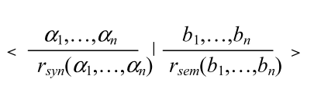
We can represent an application of an inference rule as follows
The intended meaning is that if the (truth values of the) premises α₁,…, α_{n} satisfy conditions b₁,…,b_{n}, then the (truth value of the) conclusion r_{syn}(α₁,…,α_{n}) satisfies condition r_{sem}(b₁,…,b_{n}).

Slide 32
Define Ir: B^{F}→B^{F} by setting
Ir(v)(α) = Sup{r"(v(α₁),...,v(α_{n})) : (r',r")∈IR and r'(α₁,...,α_{n}) = α}.
and the immediate consequence operator
Ic(x) = x∨la∨Ir(x).
Then Ic is k-continuous and
D(x) = lim_{n∈N} Ic^{n}(x).

Slide 33
Definition. A proof π of a formula α is any sequence α₁,..., α_{m} of formulas such that α_{m} = α, together with related “justifications”. This means that, for any formula α_{i}, we must specify whether
(i) α_{i} is assumed as a logical axiom; or
(ii) α_{i} is assumed as an hypothesis; or
α_{i} is obtained by a rule (in this case we have to indicate the rule and the formulas in α₁,..., α_{i–1} used to obtain α_{i}).
The necessity of the justifications will be apparent in the next definition.

Slide 34
Definition 5.3. Given a proof π = α₁,..., α_{m} of α and a B-theory v : F →B, the information on α furnished by π given v is the element I(π,v) in B defined by
- I(π,v) = la(α_{m}) if α_{m} is assumed as a logical axiom,
- I(π,v) = v(α_{m}) if α_{m} is assumed as an hypothesis,
I(π,v) = r_{sem}(I(π_{i(1)},v),…,I(π_{i(n)},v)) if α_{m} is obtained by
r = (r_{syn}, r_{sem}) from α_{i(1)},…, α_{i(n)} with i(1)<m,…, i(n)<m.
Different proofs of the same formula α can give different pieces of information on the truth value of α. Then we have to “fuse” them in accordance with the following definition.

Slide 35
Proposition. For every v∈B^{F} and α∈F,
D(v)(α) = Sup_{k}{I(π,v) : π is a proof of α}.
In the case of interval k-extension
D(v)(α) = ∩{I(π,v) : π is a proof of α}.
It is easy to prove that D is a continuous closure operator.
As a matter of fact D computable in the sense given in
Biacino, L., Gerla, G. Decidability, recursive enumerability and Kleene hierarchy for L-subsets, Zeitschr. f. math. Logik und Grundlagen d. Math., Bd.35 (1989) 49-62.
Gerla G., Effectiveness and multivalued Logics, Journal of Symbolic Logic, 71 (2006) 137-162.

Slide 36
As a consequence (by admitting suitable definitions):
v decidable => D(v) effectively enumerable
v decidable and complete => D(v) decidable
So, in the case a completeness theorem holds true, i.e. D = Lc, the deduction apparatus gives a way to calculate the logical
consequence operator Lc.

Slide 38
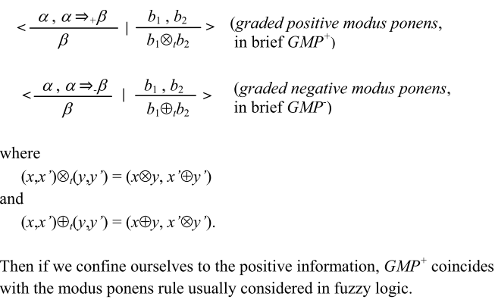
For example, let B be the square extension of a valuation structure in [0,1], then we consider two rules

Slide 39
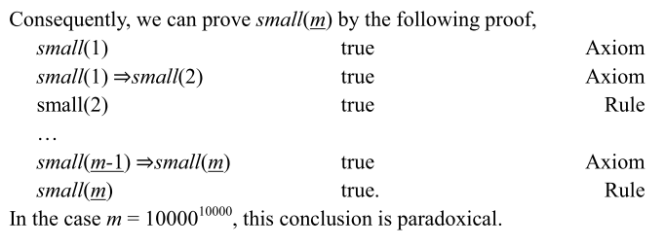

Slide 40
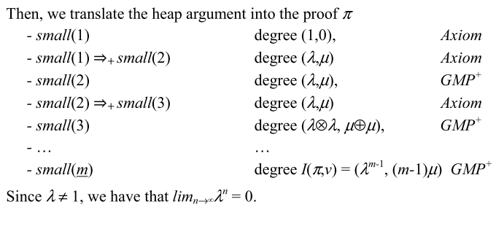

Slide 42
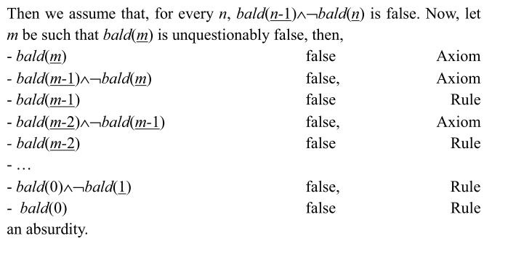

Slide 43
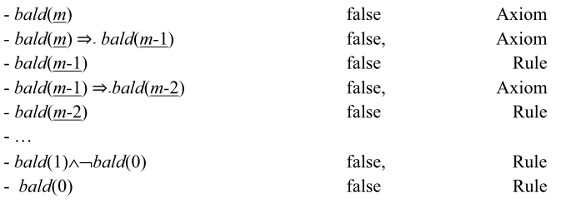

Slide 44
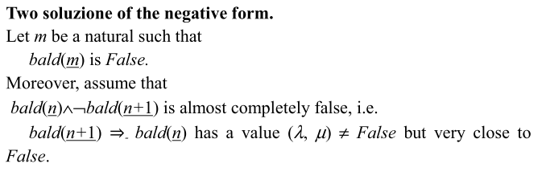

Slide 46
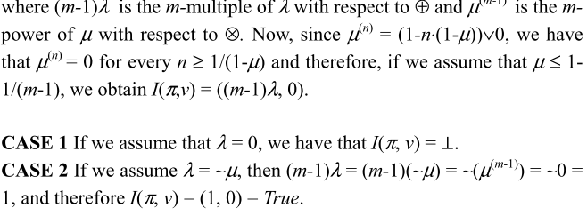

Slide 47
REFERENCES
- G. Deschrijver, O. Arieli, C. Cornelis, E. Kerre, A bilattice-based framework for handling graded truth and imprecision, International Journal of Uncertainty, Fuzziness and Knowledge-Based Systems 15 (2007) 13–41.
D. Dubois, On ignorance and contradiction considered as truth-values, Logic Journal of IGPL 16 (2008) 195–216.
M. Fitting, Fixedpoint semantics for logic programming: a survey, Theoretical Computer Science, 278 (2002) 25-51.
G. Gerla, Inferences in probability logic, Artificial Intelligence, 70 (1994) 33-52.
G. Gerla, Effectiveness and Multivalued Logics, Journal of Symbolic Logic, 71 (2006) 137-162.
- J. A. Goguen, The logic of inexact concepts, Synthese, 19 (1968/69) 325-373.
- S. Gottwald, Fuzzy Sets and Fuzzy Logic, Vieweg, Wiesbaden 1993.
- S. Gottwald, A treatise on many-valued logic, Baldock: Research Studies Press 2001.
P. Hájek, Metamathematics of Fuzzy Logic, Kluwer Academic Publishers, Dordrecht 1998.
J. Pavelka, On fuzzy logic I: Many-valued rules of inference, Zeitschrift für Mathematische Logik und Grundlagen der Mathematik, 25 (1979) 45-52.

