Slide 1



Quantumness versus entanglement in quantum measurements
Gerardo Adesso

Slide 2
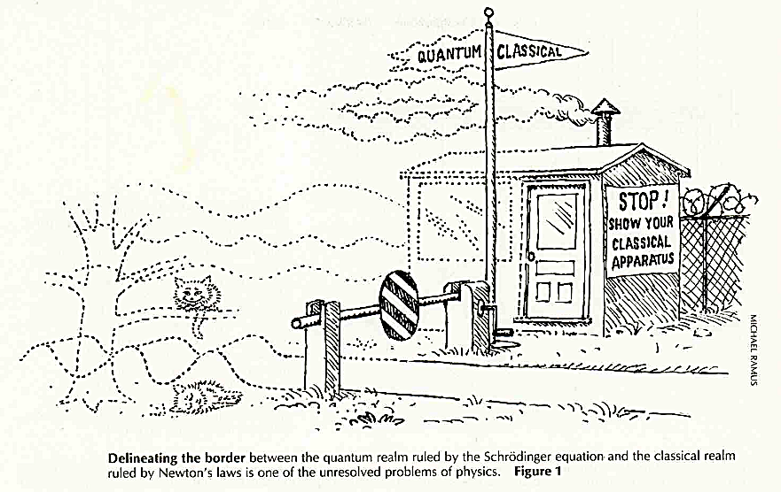
This talk is about…
Zurek Physics Today 1991

Slide 3

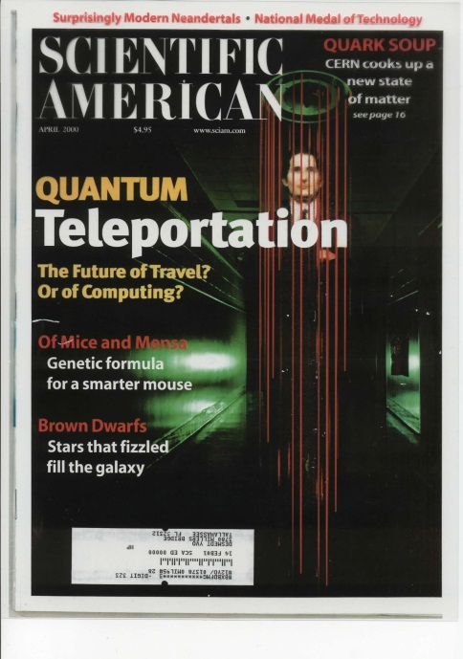

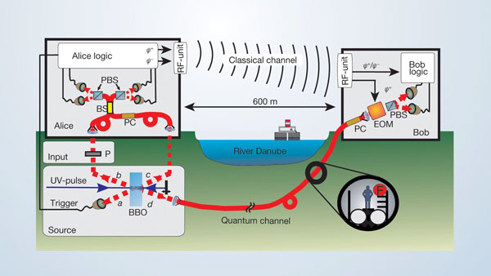
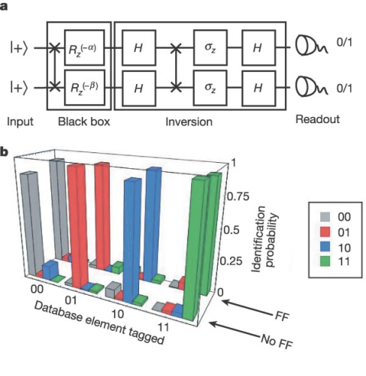

Entanglement
a resource for novel information processing
Quantum cryptography
Quantum teleportation
Quantum computation

Slide 4
Quantum correlations
a resource for novel information processing
In certain schemes of quantum computation where the quantum bits are affected by noise, there seems to be a speed-up over classical scenarios even in the presence of negligibly small or vanishing entanglement (A. Datta et al. 2008-2011)
What is the ultimate resource making quantum processors more effective than classical ones?
A more refined analysis of the nature of correlations in composite quantum systems is in order
Quantum computation

Slide 5
Correlations
Classical correlations
A
B
Quantum correlations

Slide 6
Correlations
Pure global composite states:
  entanglement = nonlocality nonclassicality (quantum correlations)
Mixed global composite states:
  Werner 1989: separable = classically correlated

Slide 7
Quantumness in separable states
Nonorthogonal separable states cannot be discriminated exactly
Measuring a local observable on a separable bipartite state can perturb the state
The eigenvectors of a separable state can be entangled superpositions
…
In general separable states have not a purely classical nature

Slide 8
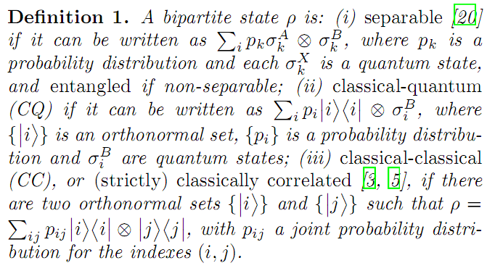
A better paradigm
M. Piani, P. Horodecki, R. Horodecki, PRL 2008

Slide 9
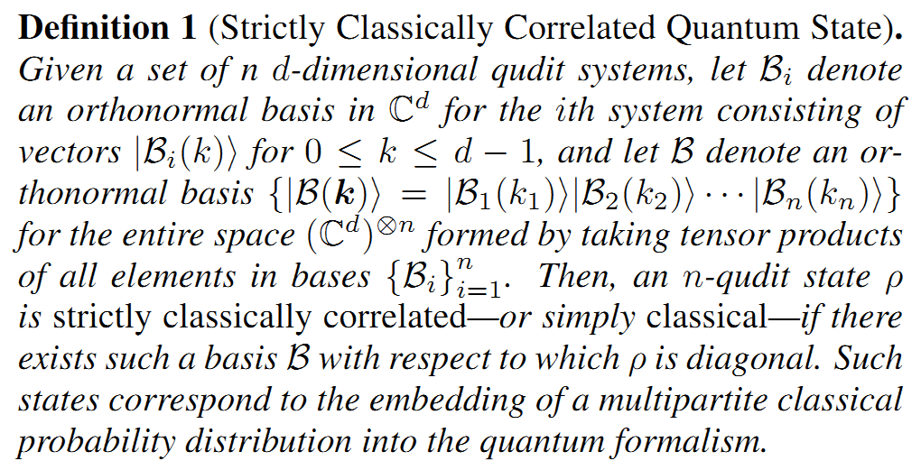
General definition
arXiv:1103.4032

Slide 10
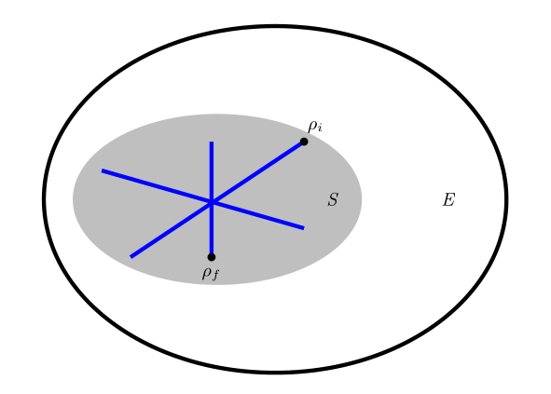
Non-classical correlations
Almost all bipartite states have non-classical correlations (strictly classically correlated states are of zero measure) A. Ferraro et al. PRA 2010

Slide 11
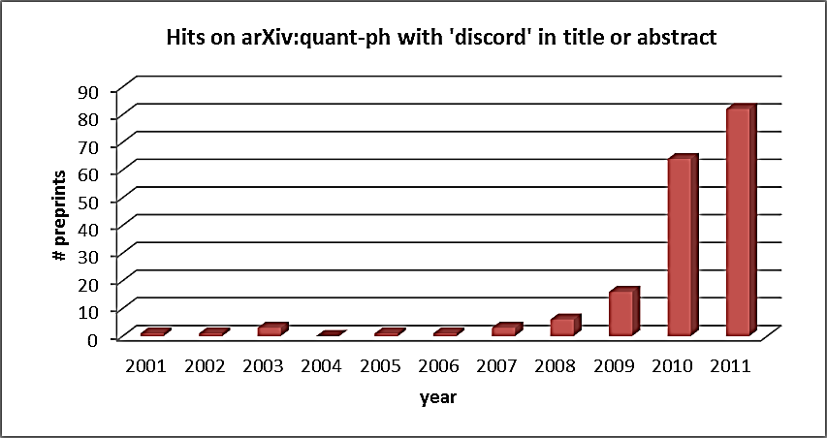
Quantum discord
A measure that strives at capturing all non-classical correlations, beyond entanglement, which can be nonzero also in separable states
Introduced a decade ago in two independent works (Ollivier/Zurek and Henderson/Vedral)
Recently became very popular: stats from arXiv:quant-ph…

Slide 12
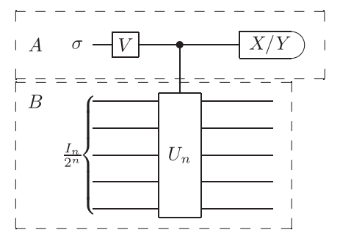
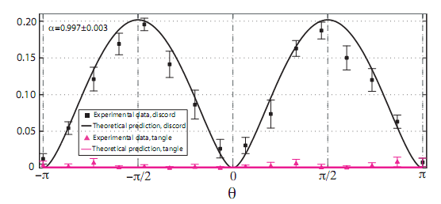
Quantum computation
Non-classical correlations without entanglement allow for a computational speed-up in the DQC1 model of noisy quantum computation
A. Datta et al. 2008-2011;
experiments: M. Barbieri et al. PRL 2008 (photons);
Laflamme group, Serra group, 2011 (NMR)
discord
entanglement

Slide 13

Quantumness in separable states
Nature June 2011
Nonorthogonal separable states cannot be discriminated exactly
Measuring a local observable on a separable bipartite state will perturb the state
The eigenvectors of a separable state can be entangled superpositions
…
In general separable states have not a purely classical nature

Slide 14
Non-classical correlations
Mathematics: how to qualify and quantify them properly?
Understanding: what is their interplay with entanglement?
Fundamentals: what role do they play in quantum theory?
Applications: are they useful for information processing?
Experiments: how to detect them efficiently?

Slide 15
Quantifying non-classical correlations

Slide 16
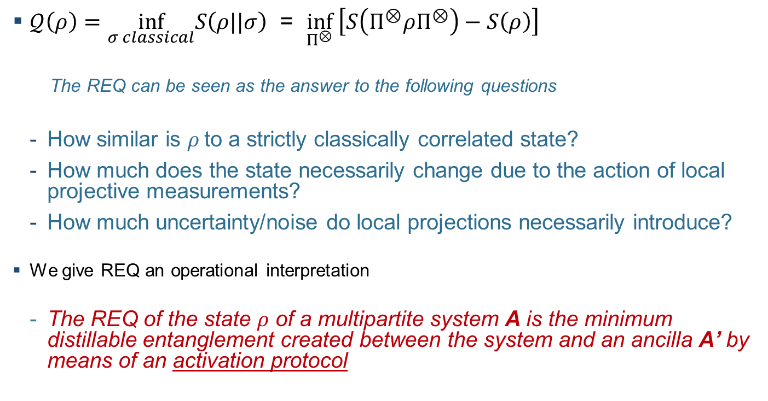
Relative entropy of quantumness
S. Bravyi, PRA 2003; K. Modi et al. PRL 2010
$𝒬\left(ρ\right)=\inf_{σ classical}S\left(ρ||σ\right)$ = $\inf_{Π^{⊗}} \left[S\left(Π^{⊗}ρΠ^{⊗}\right)−S\left(ρ\right)\right]$
  The REQ can be seen as the answer to the following questions
  How similar is $ρ$to a strictly classically correlated state?
  How much does the state necessarily change due to the action of local projective measurements?
  How much uncertainty/noise do local projections necessarily introduce?
We give REQ an operational interpretation
  The REQ of the state $ρ$ of a multipartite system A is the minimum distillable entanglement created between the system and an ancilla A’ by means of an activation protocol

Slide 17
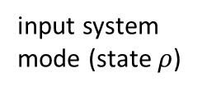
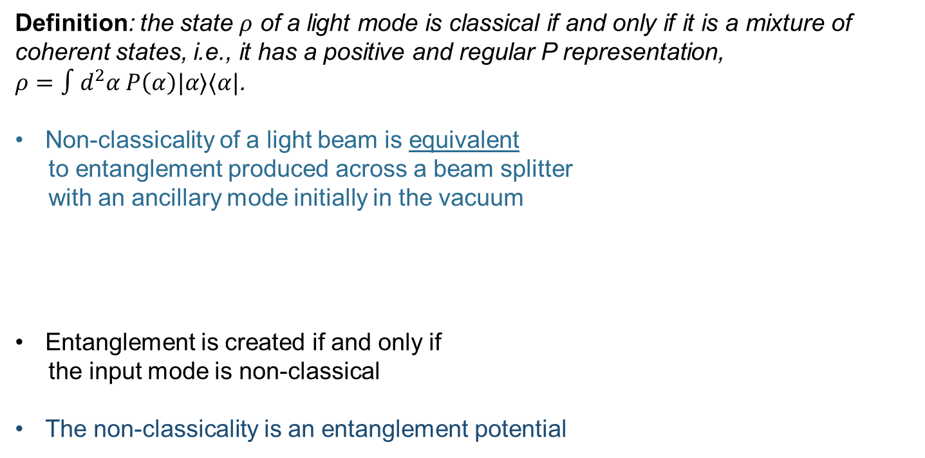
Inspiration: non-classicality of light
Definition: the state $ρ$ of a light mode is classical if and only if it is a mixture of coherent states, i.e., it has a positive and regular P representation,
$ρ=∫d^{2}α P\left(α\right)|α⟩⟨α|$.
Non-classicality of a light beam is equivalent
to entanglement produced across a beam splitter
with an ancillary mode initially in the vacuum
Entanglement is created if and only if
the input mode is non-classical
The non-classicality is an entanglement potential
output ancilla
input system mode (state $ρ$)
output system
BEAM SPLITTER 50:50
input ancillary mode (vacuum)
Asboth, Calsamiglia, Ritsch PRL 2005

Slide 18
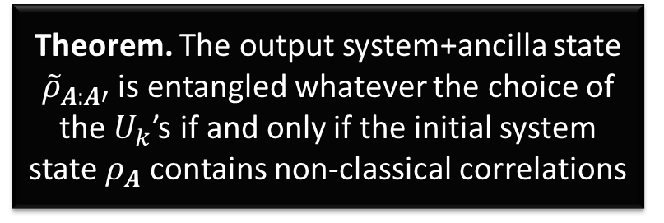
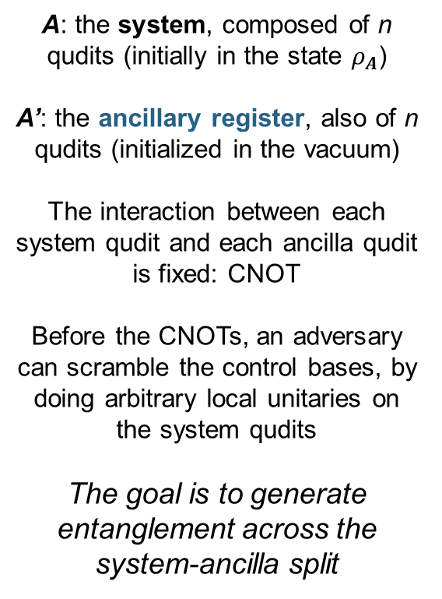
Activation protocol
Piani et al. PRL 2011
A: the system, composed of n qudits (initially in the state $ρ_{A}$)
A’: the ancillary register, also of n qudits (initialized in the vacuum)
The interaction between each system qudit and each ancilla qudit is fixed: CNOT
Before the CNOTs, an adversary can scramble the control bases, by doing arbitrary local unitaries on the system qudits
The goal is to generate entanglement across the system-ancilla split
Theorem. The output system+ancilla state ${\tilde{ρ}}_{A:A′}$ is entangled whatever the choice of the $U_{k}$’s if and only if the initial system state $ρ_{A}$ contains non-classical correlations

Slide 19
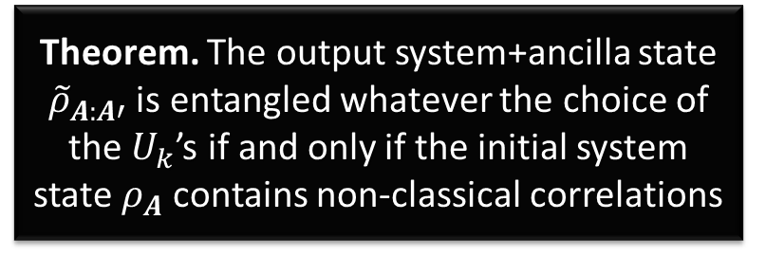
Activation protocol
Piani et al. PRL 2011
All multipartite non-classical correlations can be activated and converted to bipartite entanglement, the latter being readily usable for information processing
For classically correlated states, there is always at least one adversarial choice of local unitaries so that the output state is separable across the system-ancilla split
This establishes a qualitative equivalence between internal non-classical correlations (at the input) and system+ancilla bipartite entanglement (at the output)
Theorem. The output system+ancilla state ${\tilde{ρ}}_{A:A′}$ is entangled whatever the choice of the $U_{k}$’s if and only if the initial system state $ρ_{A}$ contains non-classical correlations

Slide 20
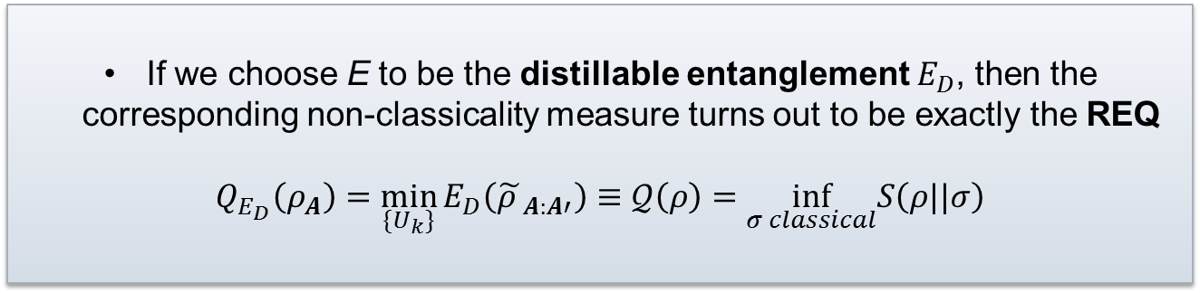
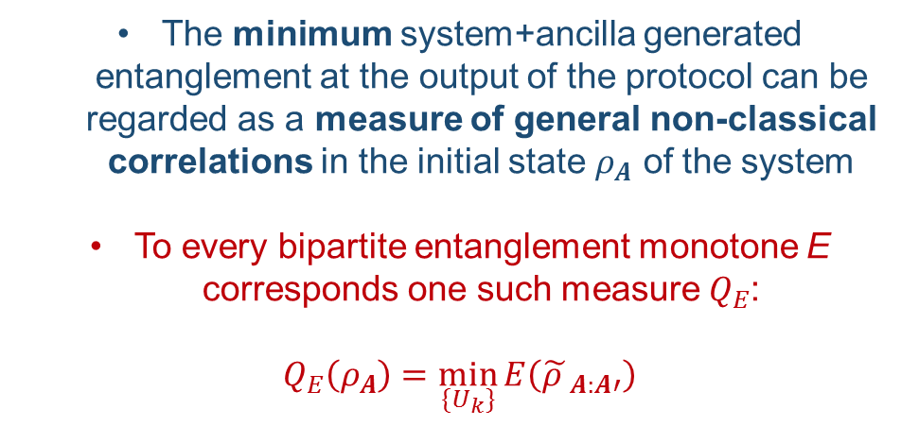
Quantitative equivalence
Piani et al. PRL 2011
The minimum system+ancilla generated entanglement at the output of the protocol can be regarded as a measure of general non-classical correlations in the initial state $ρ_{A}$ of the system
To every bipartite entanglement monotone E corresponds one such measure $Q_{E}$:
$$Q_{E}\left(ρ_{A}\right)=\min_{\{U_{k}\}}{E\left({\tilde{ρ }}_{A:A′}\right)}$$
If we choose E to be the distillable entanglement $E_{D}$, then the corresponding non-classicality measure turns out to be exactly the REQ
$$Q_{E_{D}}\left(ρ_{A}\right)=\min_{\{U_{k}\}}{E_{D}\left({\tilde{ρ }}_{A:A′}\right)}≡𝒬\left(ρ\right)=\inf_{σ classical}S\left(ρ||σ\right)$$

Slide 21

Quantitative equivalence
Piani et al. PRL 2011
Piani and GA, arxiv:1110.2530
The minimum system+ancilla generated entanglement at the output of the protocol can be regarded as a measure of general non-classical correlations in the initial state $ρ_{A}$ of the system
To every bipartite entanglement monotone E corresponds one such measure $Q_{E}$:
$$Q_{E}\left(ρ_{A}\right)=\min_{\{U_{k}\}}{E\left({\tilde{ρ }}_{A:A′}\right)}$$
The correspondence is hierarchical
$Q_{E}\left(ρ_{A}\right)≥E\left(ρ_{A}\right)$ for every E
Entanglement is only one subset of more general quantum correlations!

Slide 22
Activation protocol as a pre-measurement
Piani et al. PRL 2011
Streltsov et al. PRL 2011
Zurek RMP 2003
Quantum correlations Q in a composite system (AB) = Minimum Entanglement E between system and an apparatus generated during a local (pre-)measurement

Slide 23
Measurement processes
Piani and GA, arxiv:1110.2530
S
M₁
M₂
M₃
M_{n}
A
B
system
apparatus
photon
retina
…
consciousness?
Iterating the chain of measurements (i.e. probing the apparatus with another one etc.) both quantum correlations and entanglement can never decrease

Slide 24
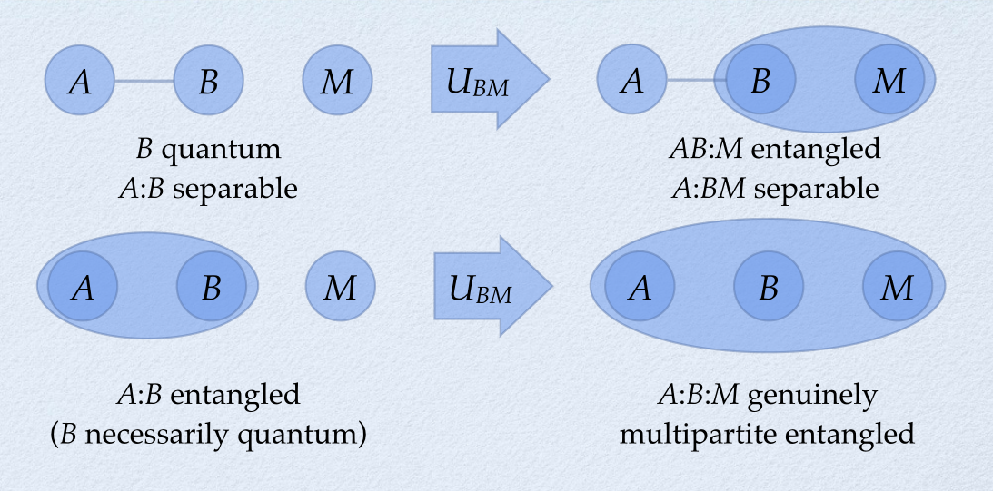
Quantumness vs multipartite entanglement
Piani and GA, arxiv:1110.2530

Slide 25
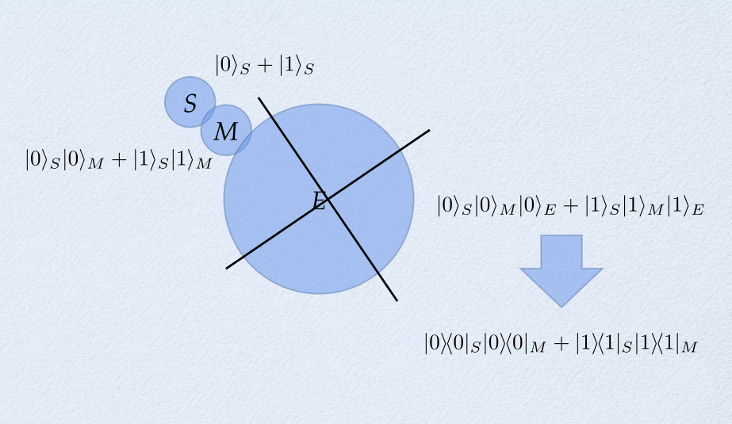
Environment induced decoherence
Piani and GA, arxiv:1110.2530

Slide 26
Structure of quantum correlations a
M. Piani et al. PRL 2011
For pure states, quantum correlations (discord and other measures) collapse onto entanglement
For mixed states, quantum correlations, once properly measured, are always bigger than entanglement
To reach the maximum quantumness of correlations, one needs the simultaneous presence of entanglement and mixedness as well
Pure maximally entangled states of 2 qudits have at most (log d) quantum correlations; the same bounds applies to separable states
Mixed entangled states can reach quantumness up to (2 log d) !! [measured by the relative entropy of quantumness]
necessarily entangled
can be separable
Non-classical correlations are enhanced by NOISE !!!

Slide 27
Quantumness in separable states
Nature June 2011
Nonorthogonal separable states cannot be discriminated exactly
Measuring a local observable on a separable bipartite state will perturb the state
The eigenvectors of a separable state can be entangled superpositions
…
In general separable states have not a purely classical nature

Slide 28
Applications
Quantum computation with noisy quantum bits (DQC1, one-way)
Locking of classical information into quantum states
Metrology with mixed probes
Quantum state merging and the “mother” protocol for communication
Remote state preparation
Assessing (non-)Markovianity of quantum evolutions?
Novel fault-tolerant communication schemes?

Slide 29
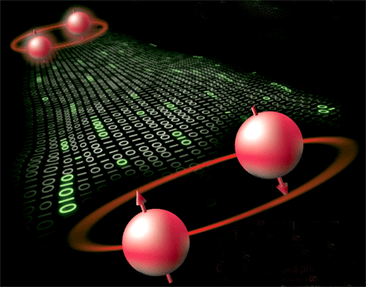
Conclusions
Quantum systems possess general non-classical correlations that go beyond entanglement
Their characterisation is relevant to address foundational issues such as the quantum to classical transition
These correlations are robust and survive up to high level of noises and macroscopic scales
They enable better-than-classical quantum computation with mixed resources
We can map them to more familiar entanglement naturally in the measurement process
Their practical usefulness in mainstream quantum communication and information processing is under scrutiny

Slide 30

Future directions
Characterise and harness quantumness
beyond the quantum world
Fundamentals
  We want to understand the ultimate signatures of quantum behaviour and how to detect them experimentally in increasingly complex systems
Applications
  We want quantum technology to take the leap out of the lab into the real world

Slide 31

Thank you
M. Piani, S. Gharibian, GA, J. Calsamiglia, P. Horodecki, A. Winter,
Phys. Rev. Lett. 106, 220403 (2011)
M. Piani and GA, arXiv:1110.2530 (2011)

